Slide 1
Guidelines, Principles, and Theories
Designing the User Interface:
Strategies for Effective Human-Computer Interaction
Fifth Edition
Ben Shneiderman & Catherine Plaisant
in collaboration with
Maxine S. Cohen and Steven M. Jacobs

Slide 2
The 8 golden rules of interface design
Strive for consistency
Cater to universal usability
Offer informative feedback
Design dialogs to yield closure
Prevent errors
Permit easy reversal of actions
Support internal locus of control
Reduce short term memory load
2-<number>
Notes:
Design dialogs to yield closure. Sequences of actions should be organized into
groups with a beginning, middle, and end. Informative feedback at the completion
of a group of actions gives operators the satisfaction of accomplishment,
a sense of relief, the signal to drop contingency plans from their
minds, and a signal to prepare for the next group of actions. For example,
e-commerce web sites move users from selecting products to the checkout,
ending with a clear confirmation page that completes the transaction.
Support internal locus of control. Experienced operators strongly desire the
sense that they are in charge of the interface and that the interface responds
to their actions. Surprising interface actions, tedious sequences of data
entries, inability to obtain or difficulty in obtaining necessary information,
and inability to produce the action desired all build anxiety and dissatisfaction.
Reduce short term memory load:
The limitation of human information processing
in short-term memory (the rule of thumb is that humans can remember
"seven plus or minus two chunks" of information) requires that displays be
kept simple, multiple-page displays be consolidated, window-motion frequency
be reduced, and sufficient training time be allotted for codes,
mnemonics, and sequences of actions.

Slide 3
Conceptual, semantic, syntactic, and lexical model
Foley and van Dam four-level approach
  Conceptual level:
    User's mental model of the interactive system (Knowledge and Mental Models in HCI by Amir Khella)
  Semantic level:
    Describes the meanings conveyed by the user's command input and by the computer's output display
  Syntactic level:
    Defines how the units (words) that convey semantics are assembled into a complete sentence that instructs the computer to perform a certain task
  Lexical level:
    Deals with device dependencies and with the precise mechanisms by which a user specifies the syntax
Approach is convenient for designers
  Top-down nature is easy to explain
  Matches the software architecture
  Allows for useful modularity during design
2-<number>

Slide 4
A dialog is the construction of interaction between two or more beings or systems. In HCI, a dialog is studied at three levels −
Lexical − Shape of icons, actual keys pressed, etc., are dealt at this level.
Syntactic − The order of inputs and outputs in an interaction are described at this level.
Semantic − At this level, the effect of dialog on the internal application/data is taken care of.
2-<number>

Slide 5
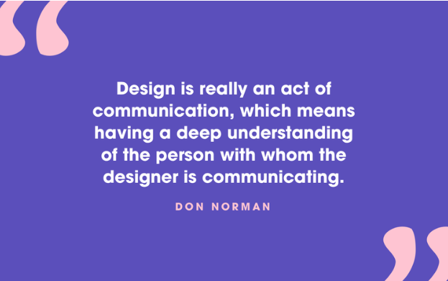
Stages of action models
Norman's seven stages of action
  Forming the goal
  Forming the intention
  Specifying the action
  Executing the action
  Perceiving the system state
  Interpreting the system state
  Evaluating the outcome.
2-<number>

Slide 6
Stages of action models (cont.)
Four principles of good design
  State and the action alternatives should be visible
  Should be a good conceptual model with a consistent system image
  Interface should include good mappings that reveal the relationships between stages
  User should receive continuous feedback
Four critical points where user failures can occur
  Users can form an inadequate goal
  Might not find the correct interface object because of an incomprehensible label or icon
  May not know how to specify or execute a desired action
  May receive inappropriate or misleading feedback
2-<number>

Slide 7
Consistency through grammars
Inconsistent action verbs
  Take longer to learn
  Cause more errors
  Slow down users
  Harder for users to remember
2-<number>

Slide 8
The disappearance of syntax
Users must maintain excess of device-dependent details in their human memory.
  Which action erases a character
  Which action inserts a new line after the third line of a text file
  Which abbreviations are permissible
  Which of the numbered function keys produce the previous screen.
2-<number>

Slide 9
The disappearance of syntax (concluded)
Minimizing these burdens is the goal of most interface designers
  Modern direct-manipulation systems
  Familiar objects and actions representing their task objects and actions.
  Modern user interface building tools
  Standard widgets
2-<number>

